Slide 1
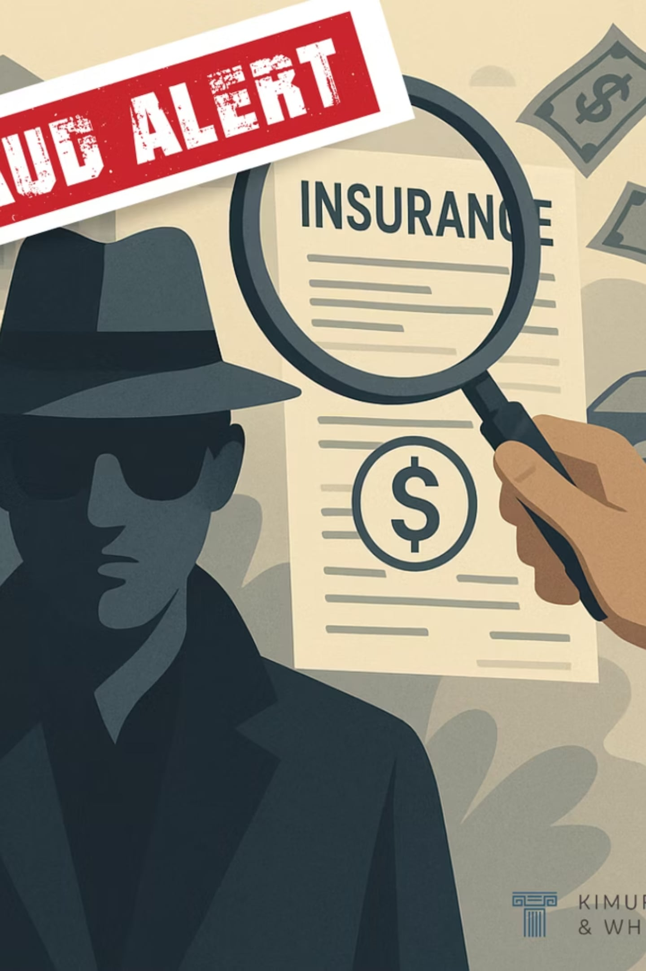
Credit Card Fraud Detection using Machine Learning
Internship Presentation | Presented by: Rishika

Slide 2



Problem & Objective
Our Goal
The Threat
Use machine learning to automatically spot fake transactions before any damage is done.
Growing Digital Payments
Fraudsters steal money by misusing credit card details, causing billions in losses globally.
More people are shopping and paying online every day — creating more opportunities for fraud.

Slide 3
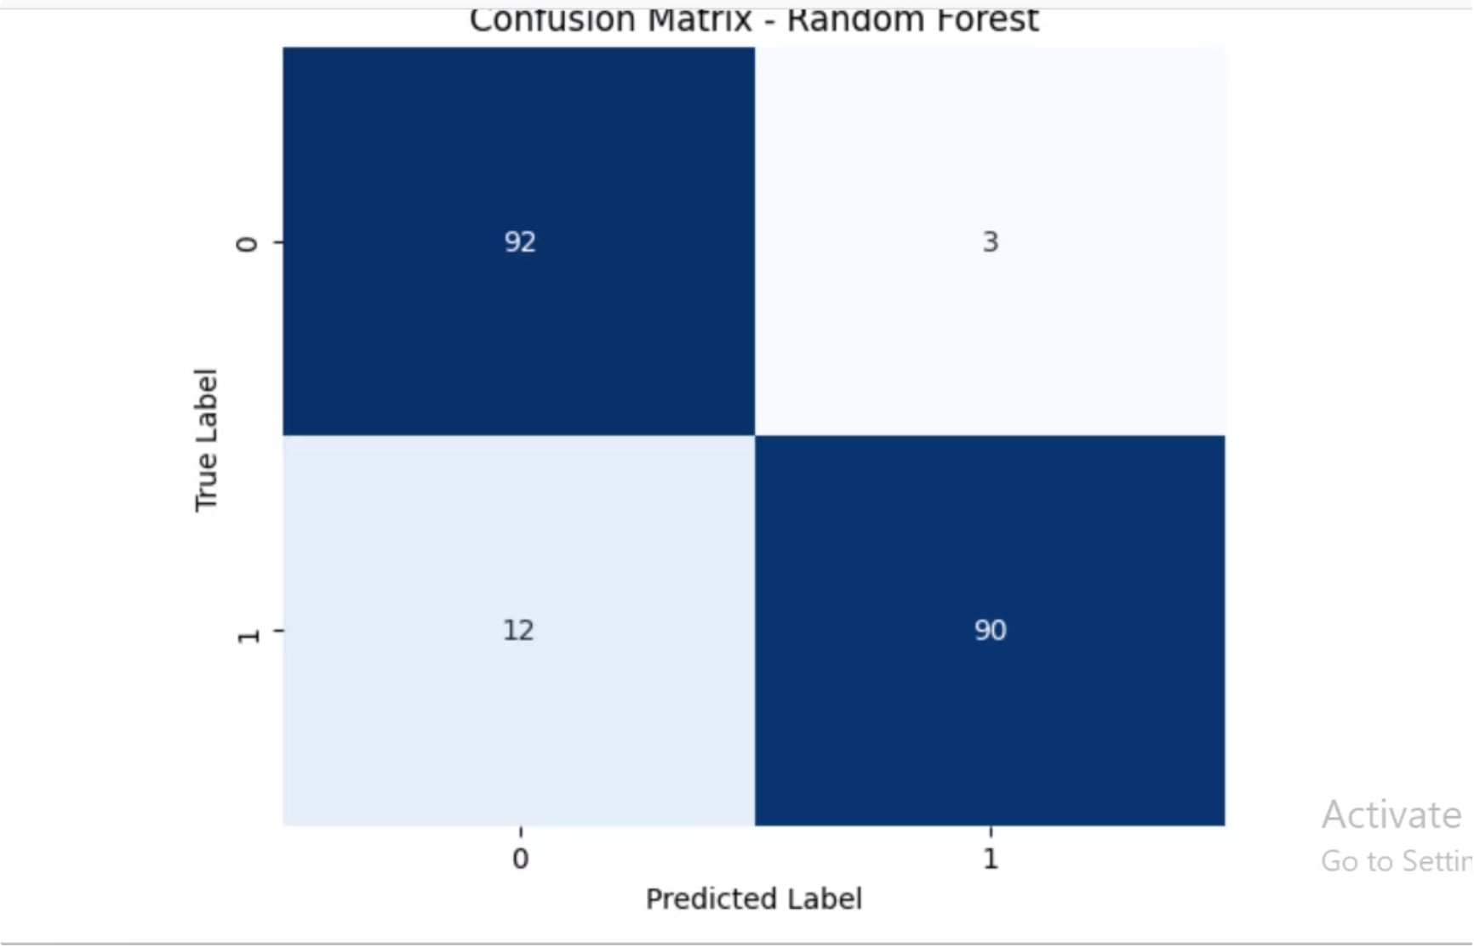
Dataset & Preprocessing
DATA OVERVIEW
284,807 Real Transactions
A large dataset of real credit card transactions was used as the foundation for training our models.
Challenge: Very few transactions are fraud — the data is heavily unbalanced
Cleaning: Removed unwanted noise and irrelevant data points
Fix: Used random undersampling to make fraud and normal cases equal in number

Slide 4



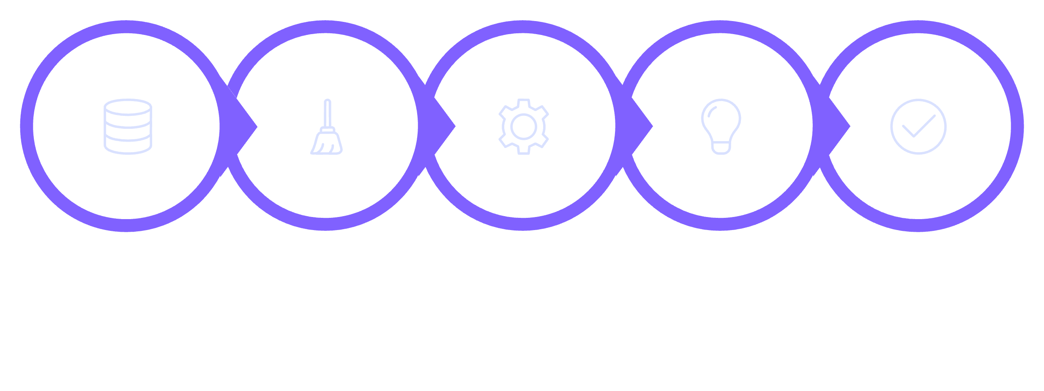
Machine Learning Models
Three models were trained and tested to find the best approach for detecting fraud.
Logistic Regression
Random Forest
Gradient Boosting
A simple yet powerful model that classifies transactions as fraud or legitimate.
Combines many decision trees to improve prediction accuracy and reduce errors.
Builds models step by step, each one correcting the mistakes of the previous.
Collect Data
Clean Data
Train Model
Make Predictions
Check Accuracy

Slide 5
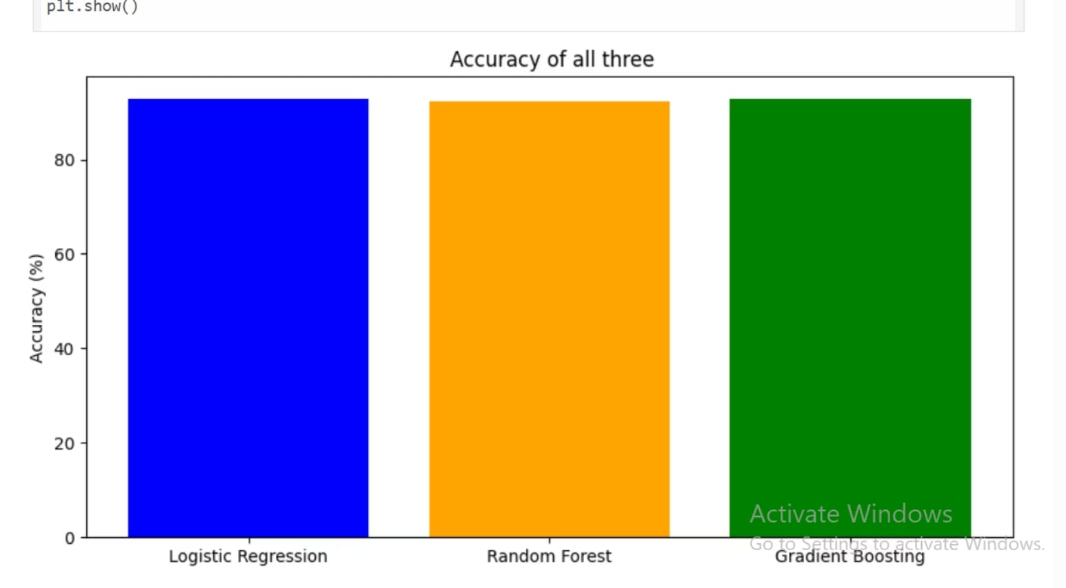

Results
MODEL COMPARISON
Best Performing Model
Logistic Regression achieved the highest accuracy at 93.40% — making it the best model overall for this dataset.
Logistic Regression: 93.40% accuracy
Random Forest: 91.88% accuracy
Gradient Boosting: 91.37% accuracy
All three models performed above 91%, showing that machine learning is highly effective for fraud detection.

Slide 6


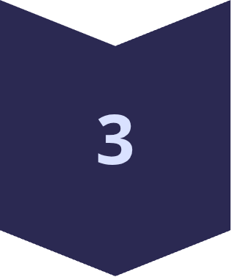
Conclusion & Future Work
What We Built
A model that correctly identifies fraudulent transactions with over 93% accuracy.
What We Learned
How to clean data, fix class imbalance, and evaluate multiple ML models effectively.
Next Steps
Build a web app using Flask or Streamlit, explore deep learning, and detect fraud in real time.

Slide 7
THANK YOU..!

